Slide 1
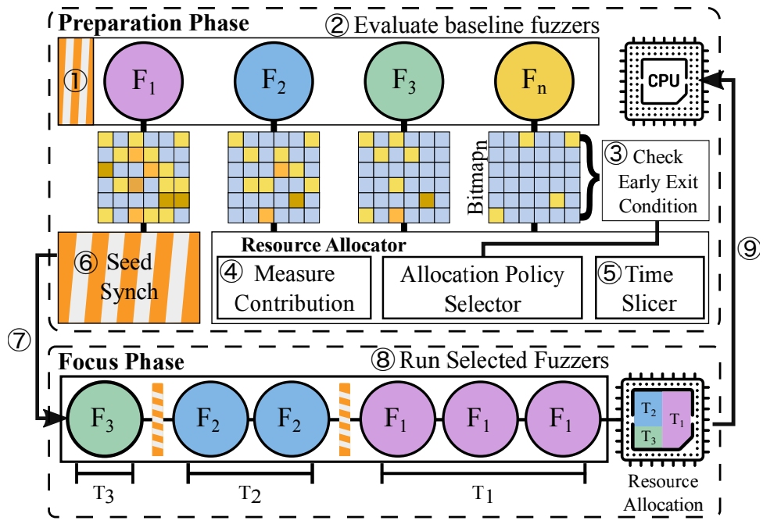

“ARMy Fuzzing”: Mid-Term Update
Kate Smith, Drew York
CPSC 8570-843

Slide 2

Research Motivations
Working Title: “ARMy Fuzzing:” Metrics for comparably Efficient Fuzzing on Commodity, Portable [ARM64] Devices.
Problem statement: We seek to confirm the effectiveness of autofz on commodity, portable ARM64 devices. We also seek to identify at least 1 alternate metric for efficient fuzzer selection.
Background: [4]
The popularity of fuzzing has grown over time, used to identify defects and even vulnerabilities in software.
Given diversity of fuzzers, selecting the best tool can be difficult.
YU-FU, F., LEE, J. AND KIM, T. 2023 proposed a tool, autofz, to achieve the most optimal fuzzing results from multiple fuzzing tools. Their work:
“dynamically deploy[s] different sets of fuzzers per workload based on the fuzzer evaluation[(AFL bitmap trends)] at runtime”
Require significant system resources (AMD Ryzen 9 3900 (12C/24T), 32 GB RAM, and 512 GB SSD disk space)
Uses one metric for fuzzer selection (AFL bitmap)
Demonstrated on x86_64/AMD64 architecture
Similar approach is collaborative fuzzing, which requires prior knowledge for selection
[1]

Slide 3
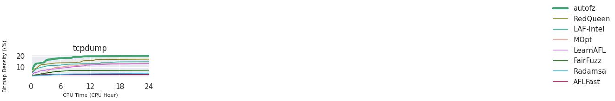
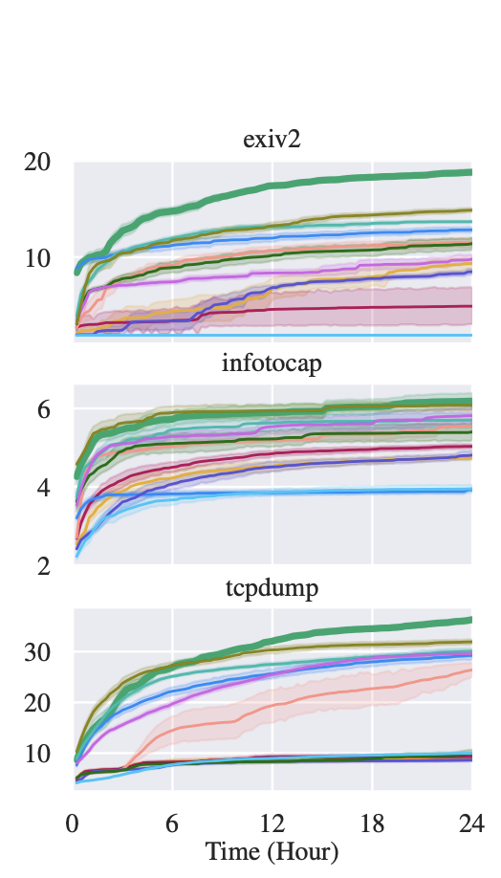
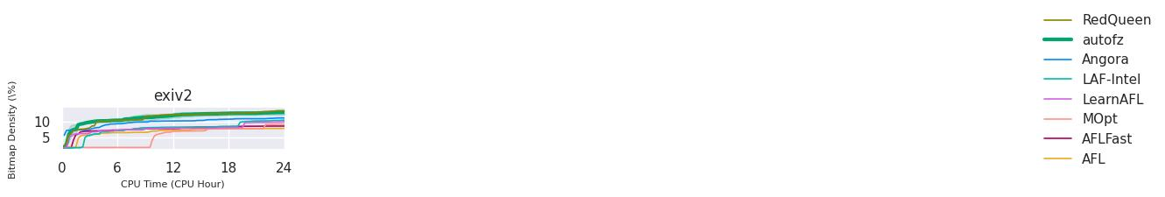
Recreating Autofz on AMD64
Recreate unmodified autofz environment with all baseline fuzzers and benchmarks
pre-built docker image
build script
Evaluate AMD64 autofz on four targets
exiv2
nm
mojs
tcpdump
Compare outcomes of presented AMD64 autofz and recreated AMD64 autofz
Paper Results
Recreated Results

Slide 4
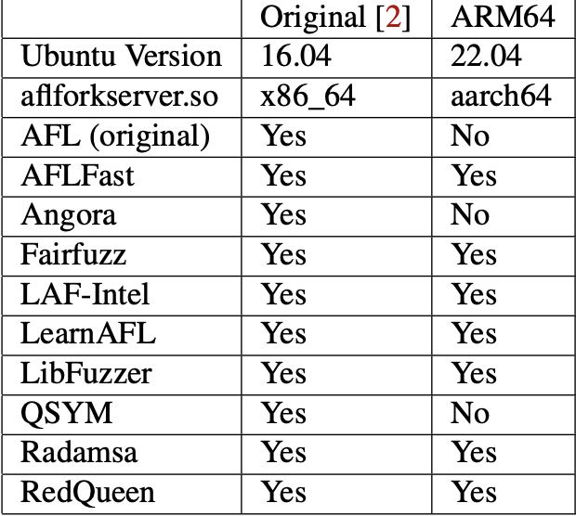
Creating Autofz on ARM64
Recreate modified autofz environment with all compatible fuzzers and benchmarks
Updated: Ubuntu 22.04
Excluded: Angora and QSYM
Evaluate ARM64 autofz on four targets
exiv2
nm
mojs
tcpdump
Compare outcomes of presented AMD64 autofz and ARM64 autofz
Paper AMD64 Results
ARM64 Results

Slide 5
Implement Additional Metric for ARM64 Autofz
Problem: autofz relies on bitmap coverage metric to rank fuzzers and allocate resources
Bitmap coverage may not be the best metric for identify the best fuzzer for a target
Bitmap coverage indicates that an area of code was fuzzed, but it does not guarantee bug discovery
i.e., while a path may be fuzzed, it may not have been fuzzed with an input that will trigger a bug
Solution: reward fuzzers that discover more bugs during the preparation phase with more resources during the focus phase
Discovering more bugs across a smaller area of code decreases the attack surface by more entry points than discovering less bugs over a greater area of the code
Next Steps: implement and evaluate performance and efficiency of alternate metric

Slide 6
Contributions thus Far
Drew:
Recreated Autofz using docker image on AMD64
Tested AMD64 Autofz against two targets
Modified Autofz for ARM64
Tested ARM64 Autofz against two targets
Kate:
Recreated Autofz using build scripts on AMD64
Tested AMD64 Autofz against two targets
Tested ARM64 Autofz against two targets
Identified additional metric for Autofz
Planned Contributions
Drew:
Continue reproduction of Results from Paper
Analyze findings from two targets (exiv2, nm) by AMD64 and ARM64 to validate original paper
Implement additional metric (unique bugs) for fuzzer composition (work with Kate)
Kate:
Continue reproduction of Results from Paper
Analyze findings from two targets (tcpdump, mojs) by AMD64 and ARM64 to validate original paper
Implement additional metric (unique bugs) for fuzzer composition (work with Drew)

Slide 7
References
[1] Anonymous 2019. AFL (american fuzzy lop). https://afl-1.readthedocs.io/en/latest/index.html.
[2] Anonymous 2020. Apple unleashes M1 . https://www.apple.com/newsroom/2020/11/apple-unleashes-m1/.
[3] ECEIZA, M., FLORES, J.L. AND ITURBE, M. 2023. Improving fuzzing assessment methods through the analysis of metrics and experimental conditions. Computers & security 124, 102946. https://dx.doi.org/10.1016/j.cose.2022.102946.
[4] YU-FU, F., LEE, J. AND KIM, T. 2023. autofz: Automated Fuzzer Composition at Runtime. arXiv.org .

